Slide 1
Predicting DEA Licensure Actions
Capstone Project Midway Review
Derek S. Wilkinson, Ph.D.

Slide 2
Project Overview
Changes that affect a health care provider’s DEA license must be reported to the National Practitioner Data Bank (NPDB).
NPDB data can answer who was reported, what happened to them (i.e., license suspension), but not necessarily why they were reported or how they behave in their natural environment.
CMS publishes a Medicare Part D data set that can answer the latter questions.
This is a research question!

Slide 3
Project Summary
Identify physicians (MDs and DOs) with a DEA licensure action in 2017.
Identify the physicians from step 1 in the 2016 CMS’s Medicare Part D public use file to find physicians’ prescribing behavior most proximal to when they were reported and allows for a full year of data.
Select a subset of controls who are “similar” to the physicians reported to the NPDB for DEA licensure actions.
Build a supervised binary classification model to predict who was and was not reported to the NPDB and identify the most influential features for that model.

Slide 4
Project Workflow
Obtain NPI for NPDB physicians
Merge NPDB data with Medicare Part D by NPI
Identify “control” physicians
Done
Done
Done
Somewhat
Done
Pre-processing
Model Building
Model Evaluation
EDA
Somewhat
Done

Slide 5
Part D Data Overview
73 variables:
Outcome (1): “Group”
Provider demographics (5)
Numeric (56): claims, cost, beneficiary counts, beneficiary demographics, other
Flag variables for suppressed data (11)
Numeric data have a large amount of missing (0 - ~75% missing)
Most data follow a Poisson distribution

Slide 6
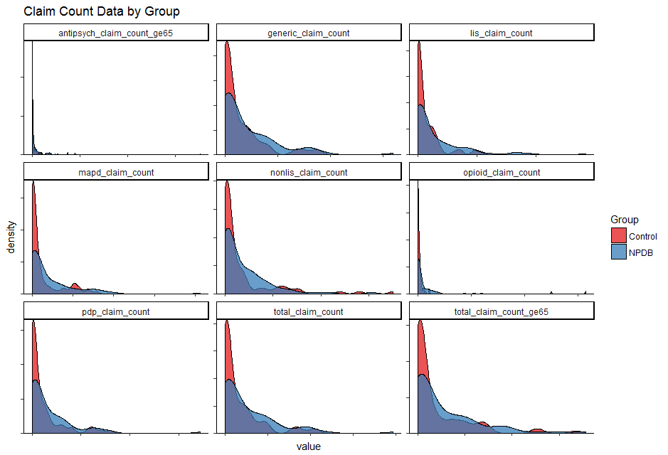
Sample Data Distribution

